Slide 1
Kerry Boyd, MD, FRCP(C)
Associate Clinical Professor, McMaster University
Dept. of Psychiatry & Behavioural Neurosciences
Chief Clinical Officer, Bethesda
AMS Phoenix Project Fellow
Notes:
Curriculum of caring is an AMS Phoenix sponsored program with many partners from across Ontario. The emphasis in this update will be on the power of personal narratives and the process of establishing evidence for use of Curriculum of Caring educational videos.

Slide 2
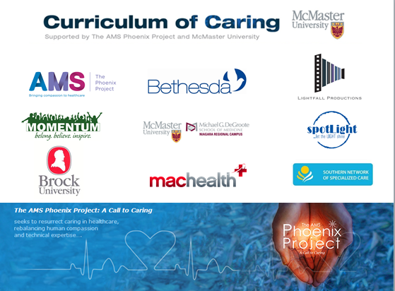

Slide 3
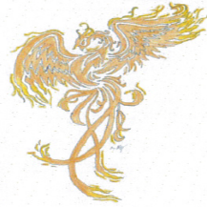
Curriculum of Caring Narrative & Evidence
Face to Face

Slide 4
C of C Narrative & Evidence : Face to Face
Mark (aka Luke Skywalker)
has a message for you…

Slide 5
I help students become better doctors
Notes:
Luke

Slide 6
Evidence … Narrative Face-off…Face on

Slide 7
Narrative & Evidence
Narrative Approach
Approach to Evidence
Power of personal perspectives
In person with students & via video available on CofC website
Participative research practices
Program evaluation, focus groups, mixed methods research
Notes:
Curriculum of Caring brings people living with intellectual and developmental disabilities together with allied health students. Personal perspectives of people with lived experience has been influencing medical and nursing students since about 2010. Program evaluation has helped to shape the Curriculum of Caring. Curriculum of Caring evolved into a web based program that includes a number of videos of personal stories or narratives. Personal narratives have been studied and found to be effective in instilling empathy and appreciation for patients perspectives. Research that includes people with developmental disabilities as not only subjects, but partners in the research process, was important to our team.

Slide 9
Aims of Curriculum of Caring
Enhance & Advance
Curriculum of Caring by developing web-based resources
Evaluate
Curriculum of Caring initiatives
Expand
the network for DD healthcare training

Slide 11
How do you want to be treated?

Slide 12
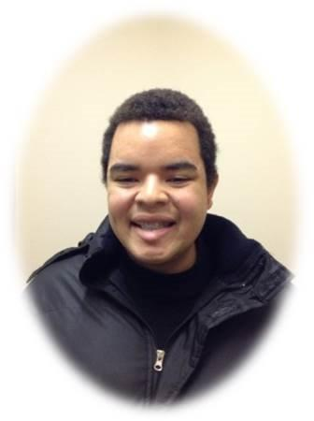
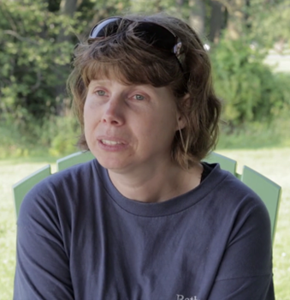
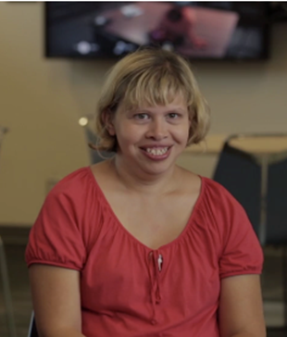
C of C Patient Educators

Slide 13
C of C Narrative Research: Intervention
Introduce first-year medical students to the IDD population.
Blended educational experience: video narratives and direct interactions with people who have lived experience with IDD.
Goal: to promote person-centered attitudes & communication in early medical trainees.
Coret, Boyd, Hobbs, Zaziluk, McConnell. Patient Narratives as a Teaching Tool: A Pilot Study of First-Year Medical Students and Patient Educators affected by Intellectual/Developmental Disabilities. Teaching and Learning in Medicine.

Slide 15
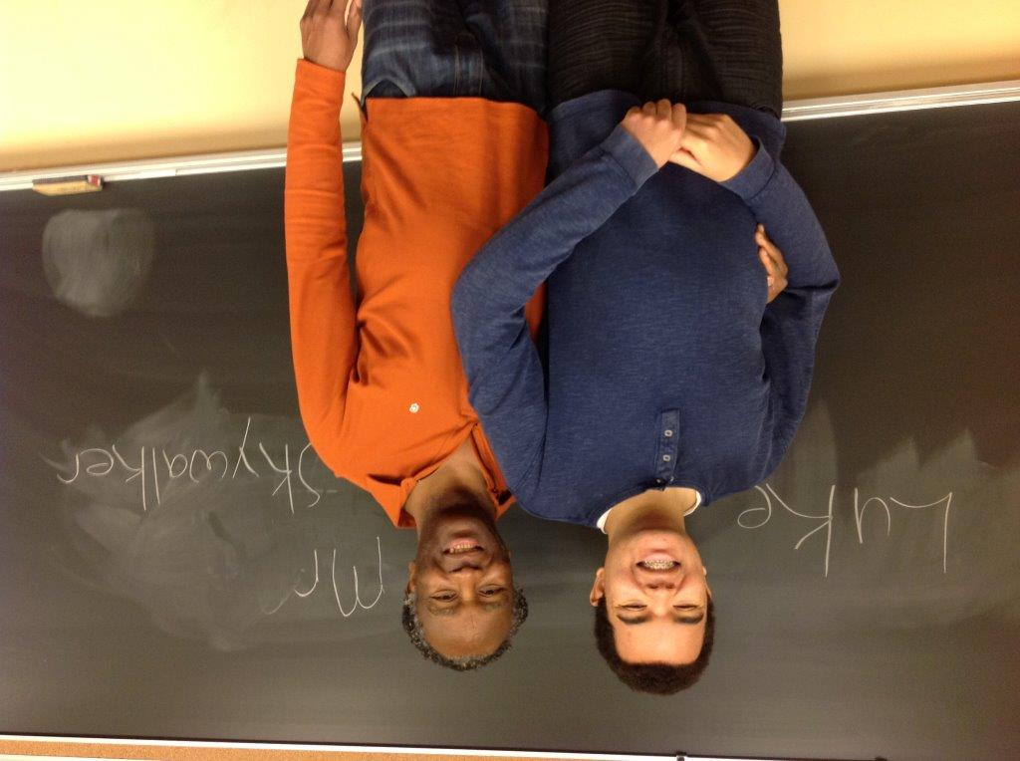

Slide 16
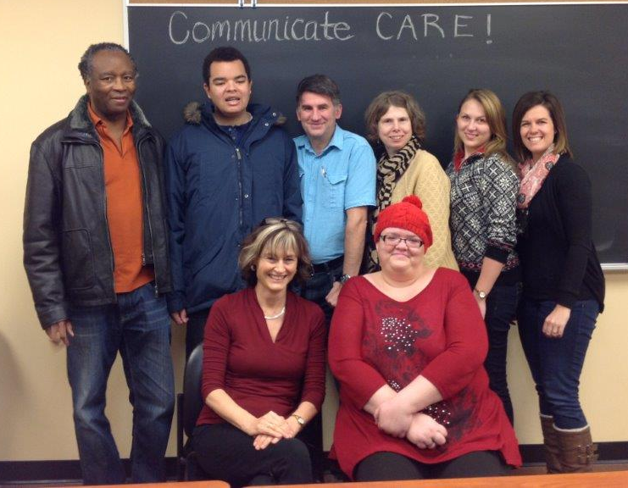

Slide 17
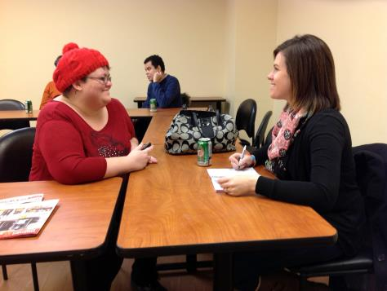
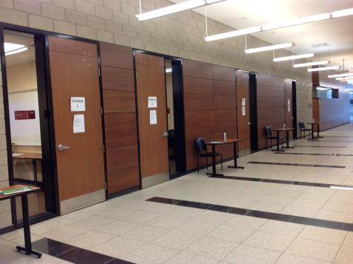
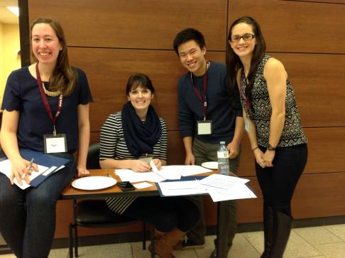
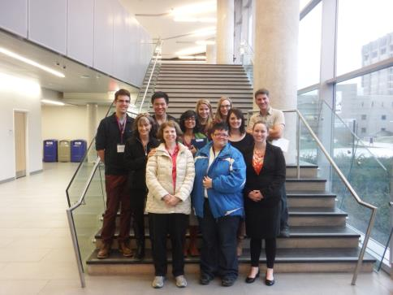

Slide 18
C of C Narrative Research: Outcomes
Descriptive analyses:
Students in the narrative group showed greater increases in self-rated measures of comfort, confidence and competence vs. control group.
Narrative group also had higher mean performance scores across all PE interview stations.

Slide 19
C of C Narrative Research: Outcomes
Focus group analysis:
All thought the blended educational experience was valuable & enjoyable.
Merits of reflecting on patient narratives.
Importance of adaptable language & engagement of people with IDD.
Feelings of discomfort from a lack of knowledge or exposure to IDD, and this discomfort motivates them to learn and develop their skills.

Slide 20
Lessons Learned- Narrative
Narrative exposure and reflection is a useful way of teaching about patients’ lived experiences, allowing students to approach clinical encounters with greater confidence.
“The videos were just so touching…you can’t help but smile when you see them and to see the experiences, and see where these people are coming from, so I found those very effective.”

Slide 21
Lessons Learned-PE Interactions
Patient educators add a powerful real-life dimension to communication skills teaching… a valuable educational approach.
“These vastly different situations were very interesting and enlightening in terms of…my own understanding of intellectual and developmental disabilities. It’s important to recognize that each person is their own individual, they’ve got different ways of communicating and…it really required a lot of adaptive skills to…be able to communicate with each patient.”

Slide 22
C of C Blended Learning & Blended Research

Slide 23
Further Research: Focus on PE/SP Experience

Slide 24
Curriculum of Caring: Knowledge Translation

Slide 25
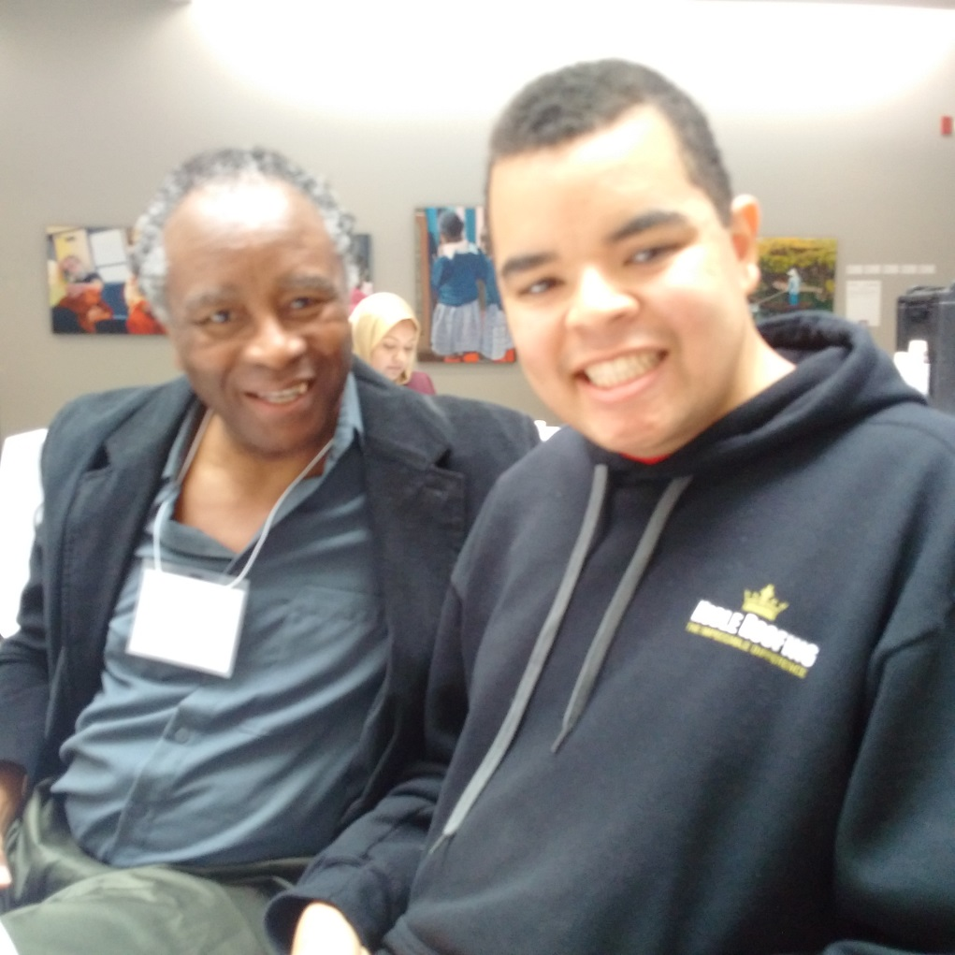
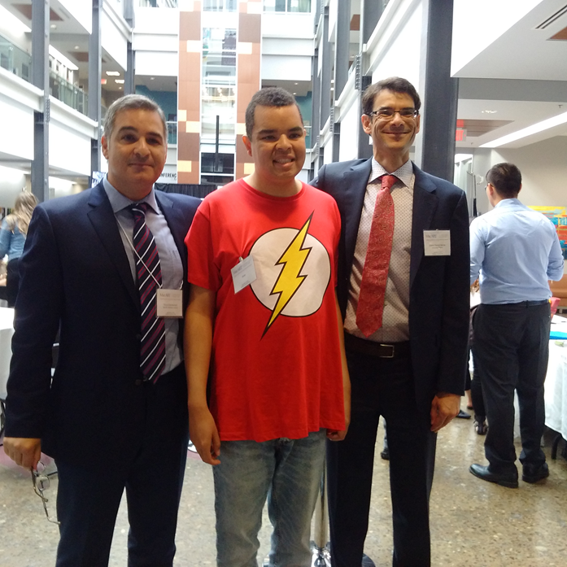
MacART Researchers of Great Stature

Slide 26
Need

Slide 27
